Slide 1

The Abstraction Ladder
“Get on Down”

Slide 2

Instructor Comments
Be specific
Lacks support
Such as?
Like what?
Give examples!
Undeveloped
No proof
Too general
Lacking in specifics

Slide 3
Terms to know
Abstract General
What are the opposites of these two terms?
Concrete Specific

Slide 4
Definitions
A generalization usually includes abstract ideas.
A specific statement usually includes more concrete items.

Slide 5
Galaxy
Abstract or Concrete?
Very abstract: Astronomers do not know where or how many galaxies there are.

Slide 6
The Ladder: from the most abstract concept to the most concrete
Galaxy
Milky Way
Solar System
Earth

Slide 7
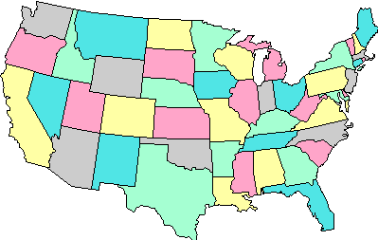
Ladder
North America
United States
Florida
Orlando
Orange County

Slide 8
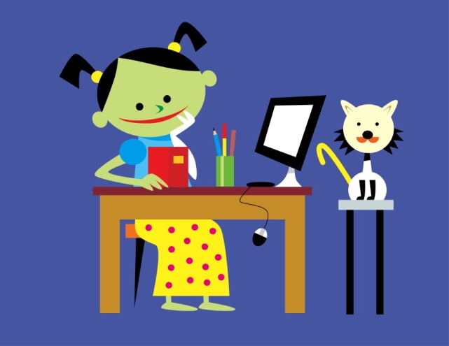
Ladder
Kirkman Road
Valencia CC Campus West
Building 4
Room 235
Professor’s Desk

Slide 9
We have gone from the most abstract concept to the most concrete.
Galaxy – most abstract/general
14. Professor’s desk – most concrete/specific

Slide 10
Compare these lists
  A. B.
Contentment a ball point pen
Hate a pink, frilly party dress
Revenge a downy, soft blanket
Jealousy a red and white bird
Spite wrapping paper
Revulsion a canon printer
Nervousness a brick house
Resentment a 25 foot, live-oak tree

Slide 11
Abstract or Concrete?
Love
Box of chocolates
Bottle of Tommy Hilfiger cologne
Anger
Slap in the face
Temper tantrum
Fear
Happiness
Dimpled smile
Sadness
Tear-stained face
Shriek at midnight

Slide 12
Can any of the specific (concrete) entries be examples of the more abstract (general)?
Love
Box of chocolates
Bottle of Tommy Hilfiger cologne
Anger
Slap in the face
Temper tantrum
Fear
Happiness
Dimpled smile
Sadness
Tear-stained face
Shriek at midnight

Slide 13

Specific Support
Bottom line:
Begin your paragraph with your most general statement, the topic sentence. Then support it with specific (concrete) details.

Slide 14
Your Turn
Here is a generalization that could be the topic sentence for a paragraph. Try to come up with ideas for specific support.
My mother has too many shoes!

